Slide 1
2008-2009 Zero-Coupon Bond Yields
Joseph Boynton and Erin Cammock

Slide 2
Motivation
Analyzing statistics and reading models is a key skills to have in the actuary science field
Topics like zero-coupon bonds and spot rates are both on the exams FM (Financial Mathematics) and IFM (Investment and Financial Markets).
Strong relationship between economic events and the insurance industry
2008 Financial Crisis: safer bonds = lower yields

Slide 3

Goals
Verify if ZCB yield rates decreased after 2008.
Test if volatility of ZCBs fluctuated from 2008 to 2009.
Welch's Two-Sample T-Test – One-sided
F-Test for Variance

Slide 4
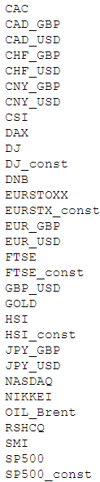
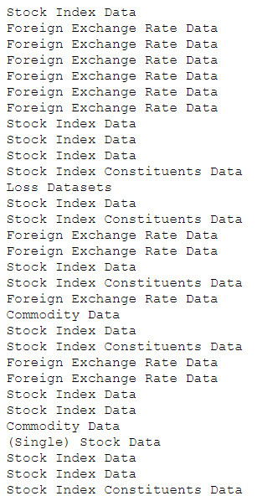
Package ‘qrmdata’
Data Sets for Quantitative Risk Management Practice
Collected in March 2024
Contains data on...
Stocks
Foreign exchange rates
Cryptocurrency
Interest rates
Commodities (Oil & Gold)
Losses from insurance claims

Slide 5
ZCB_USD
Zero-coupon bond yield curves in USD.
225,270 total data points from 1985-11-25 to 2015-12-29.
Contains the spot rates given the date and maturity of a bond.
Collected by Marius Hofert – a statistician and professor from The University of Hong Kong (Department of Statistics and Actuarial Science)
Originally obtained from Nasdaq (2016)

Slide 6
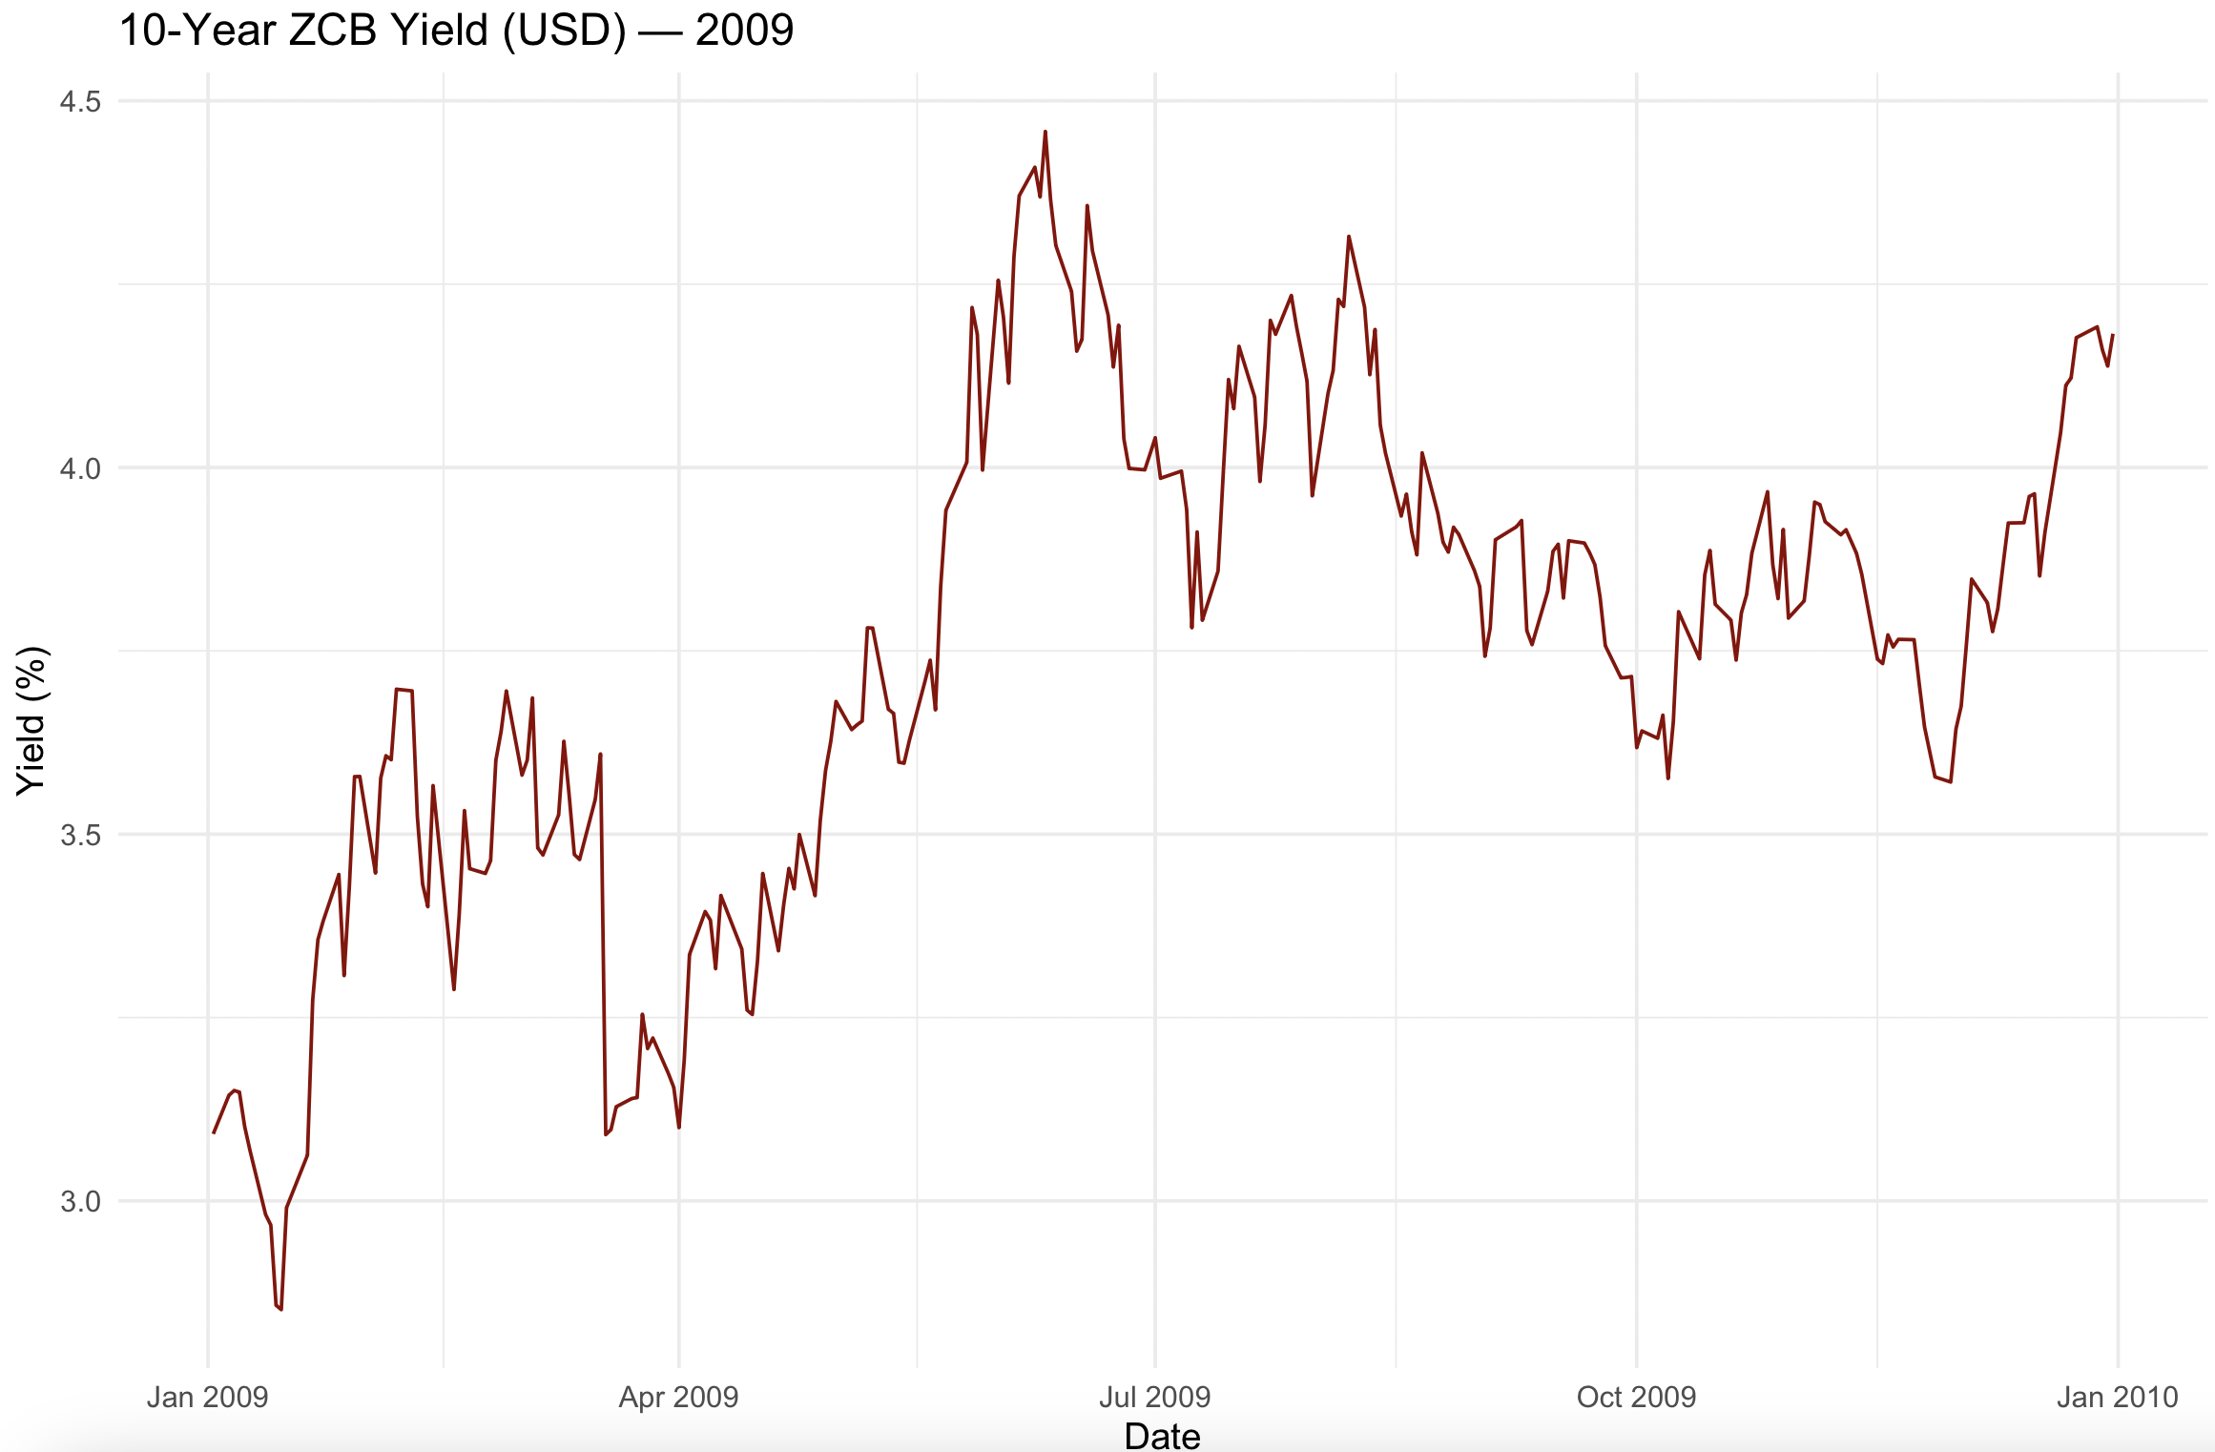
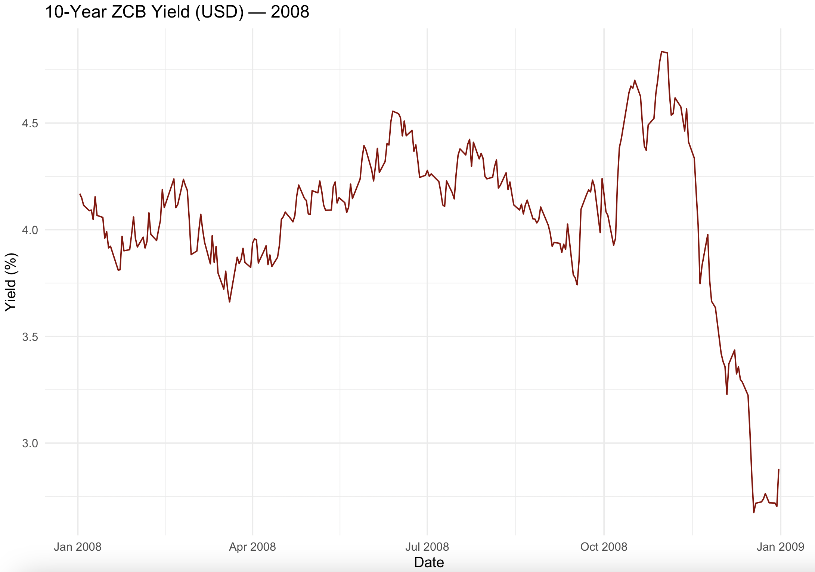
Dataset
2009, recovered back to 2008 standing in June 2009, then stayed stable
2008, relatively stable yield till Dec 2008, and had a major downturn

Slide 7
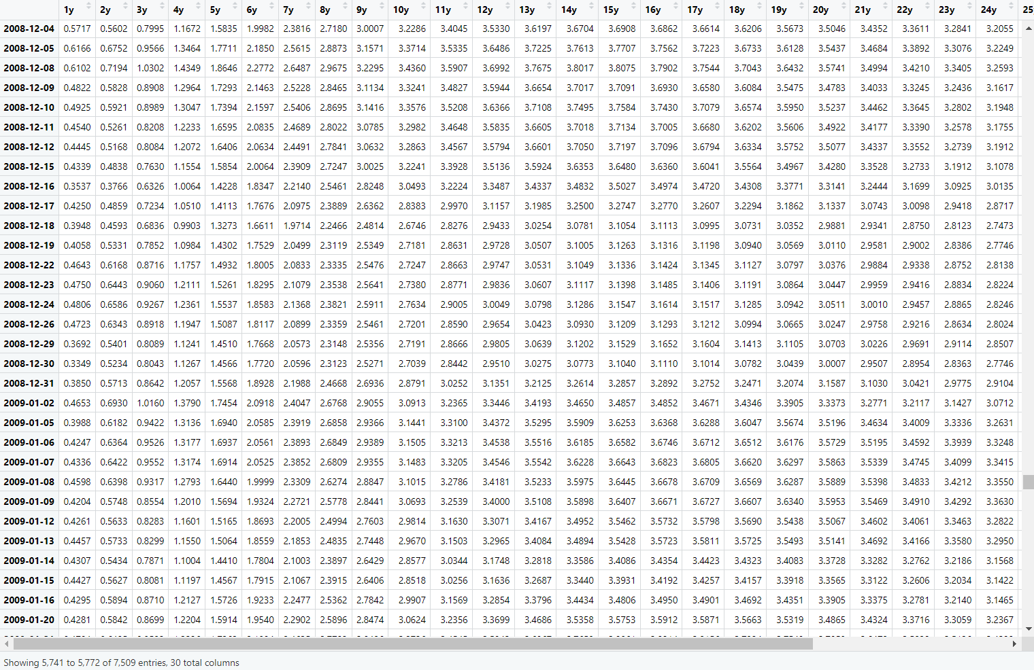

Slide 8
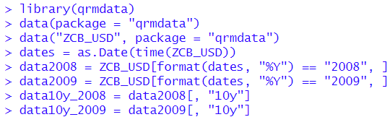
R Code
Narrows size of each sample from 7,530 and 7,500 to 251 and 250 respectively

Slide 9
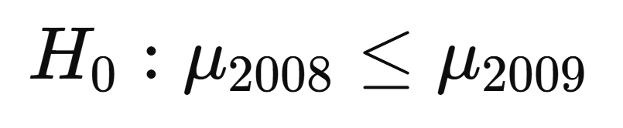
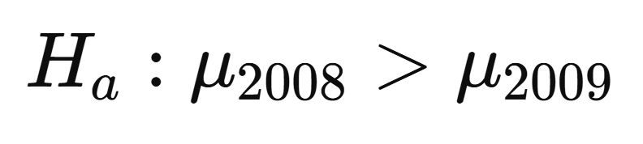
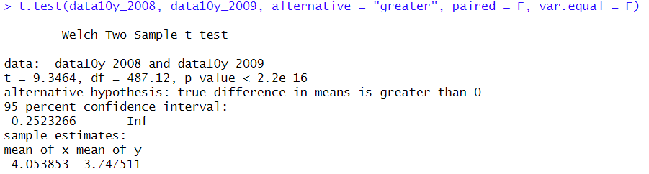

Welch's Two-Sample T-Test

Slide 10
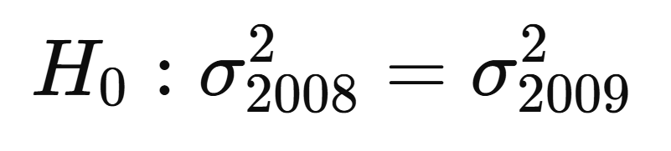
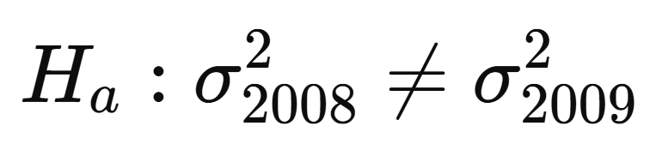
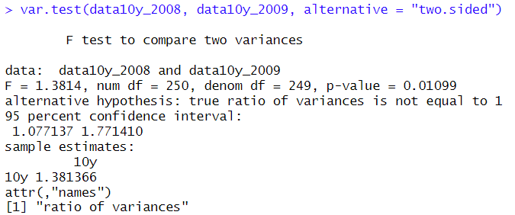

F-Test for Variance

Slide 11
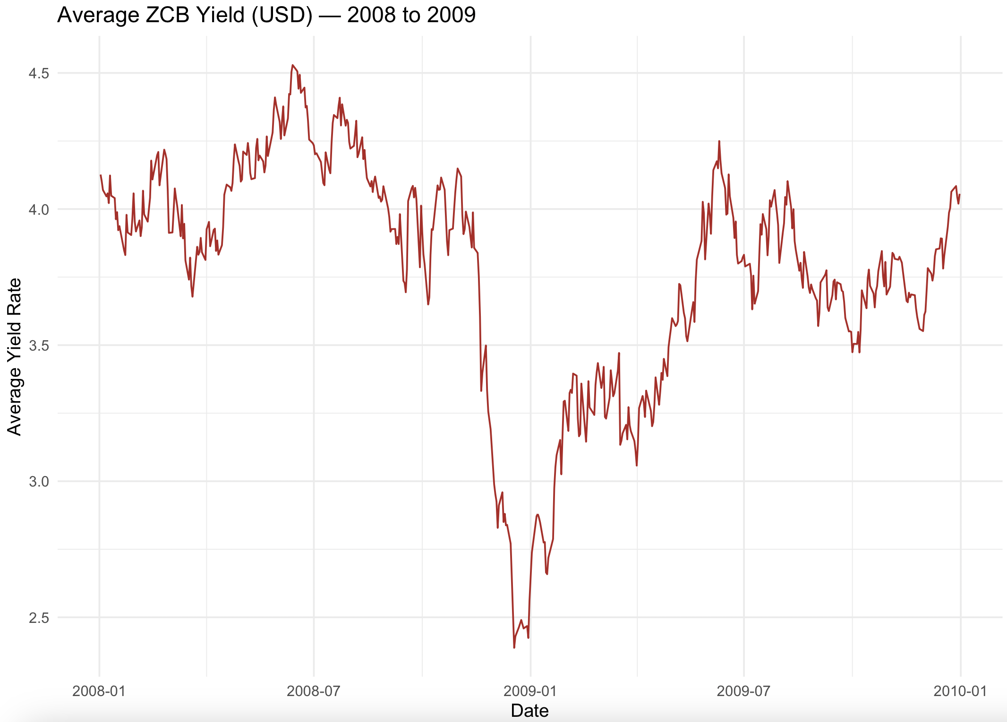
Findings/Research
The Fed and FOMC made interest rate cuts to avoid a recession and stock market crash in 2008
With the recession ending in June of 2009, the yield for the US zero-coupon recovered
The zero-coupon bond being sensitive to the real interest rate, any changes cause a significant change in yield.

Slide 12
Conclusion
Zero-coupon bond yield rates were lower in 2009 than in 2008.
Volatility changed between 2008 and 2009
This is most likely due to a shift in people's tolerance for risk. Investors became scared riskier investments might default. As demand for bonds grew due to this fear, yields fell as a result.
This signals a change in uncertainty during this period

